Slide 1
Welcome!
REDCap + R Workshop
REDCapCon 2023

Slide 2

Stephan
Notes:
TODO: bio

Slide 3

Will
Notes:
TODO: add headshot

Slide 4

Assumptions
You are somewhat familiar with REDCap
You have basic knowledge of R
You're interested in learning how to integrate REDCap and R so you can use these skills for your own work
You'd like to meet others who are also interested in this
Notes:
… but don't necessarily have in-depth knowledge about complex databases with repeated and longitudinal instruments
… but aren't necessarily an expert in using it to clean, visualize, or model data
…or at least aren't opposed to meeting them!

Slide 5
Getting Onto Posit Cloud
Notes:
Posit Cloud training environment that we’ve set up specifically for this course so you don’t have to download anything. However after the course we highly recommend you download the RStudio IDE from the Posit website. It’ll look very similar to this.

Slide 6
https://posit.cloud/content/6465016
Notes:
Log in or sign up if you don’t have an account.

Slide 7
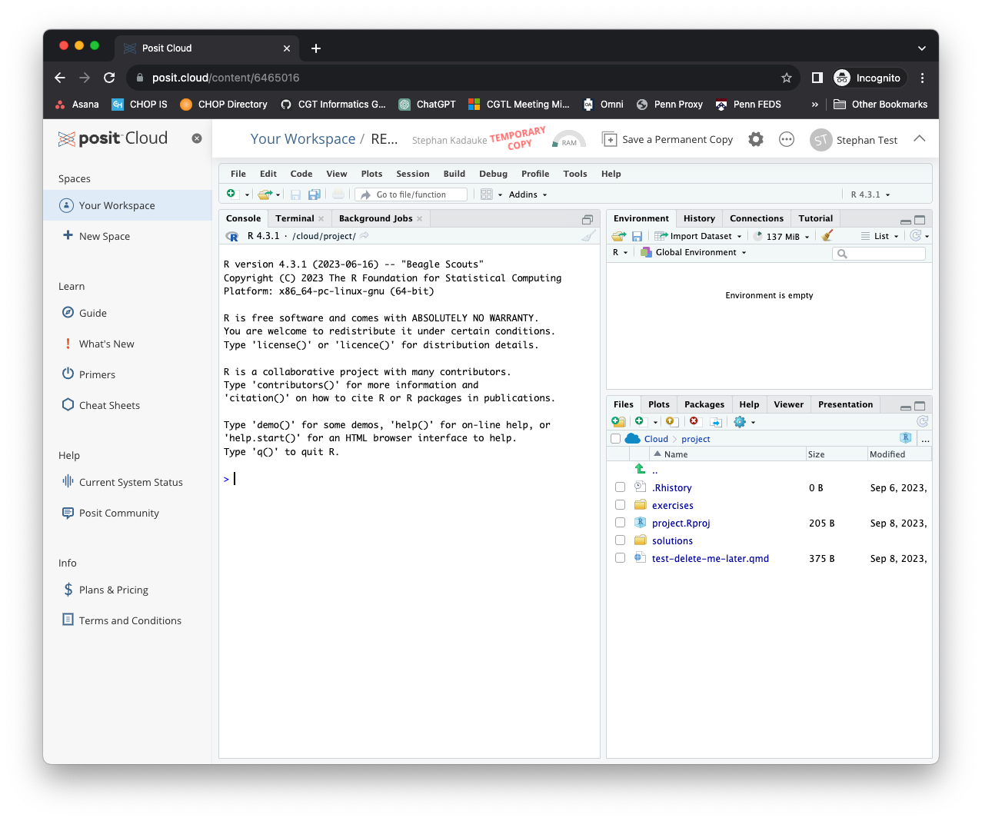
Notes:
X out the left sidebar so you have more real estate on the screen

Slide 8
Your Turn
In the Files pane on the bottom right, find the exercises folder. Click on it.
Then click on the file named 00_welcome.qmd.
A new pane will pop up with the contents of that file. Read what it says and follow the instructions to complete the exercise.

Slide 9
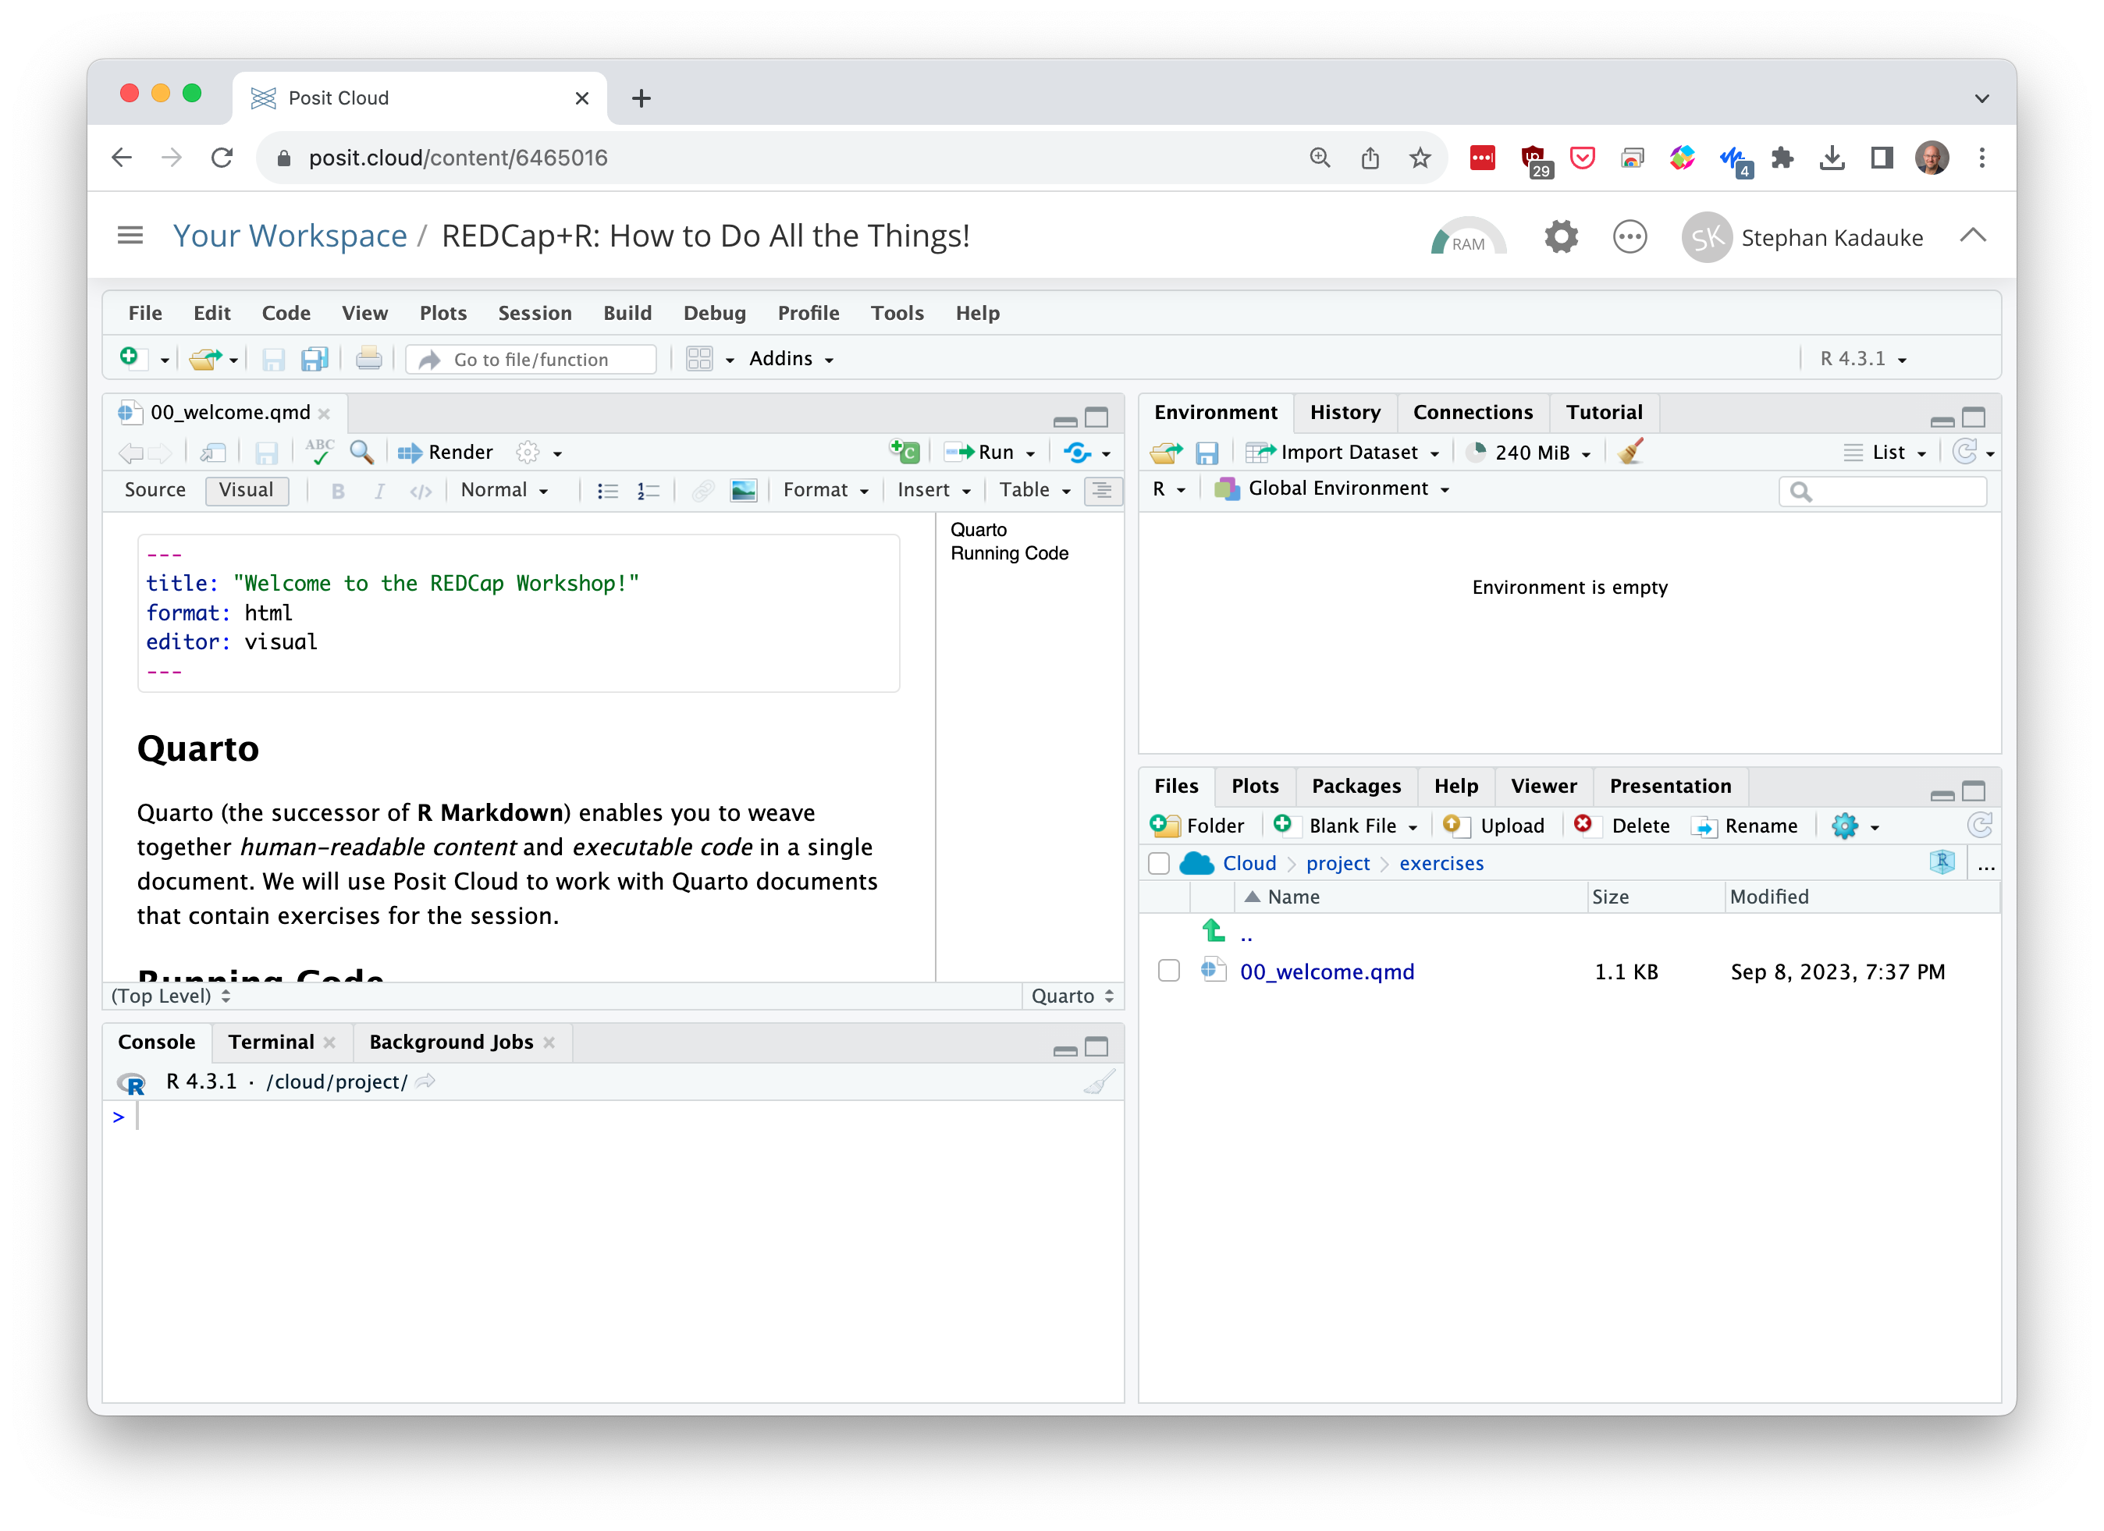
Environment
Editor
Files
(and other stuff)
Console
Notes:
Here’s what the Posit Cloud IDE looks like.
On the top left is the editor. This is where you enter code.
On the top right is the Environment. The environment allows you to look at the data that’s loaded into R. Interacting with data in the environment tab provides some of the functionality you may be familiar with from working in Excel.
The Console is on the bottom left. You can use the console quickly run an individual R command, like install a package. We won’t use the console today.
The pane I have labeled “Files and other stuff” has a few of tabs. The most important one for today is the “Files,” and you’ve already explored that. But here’s also where help pages for R commands will show.
Now redo the exercise and run the code chunks.

Slide 10


Notes:
Quarto provides a lab notebook interface for analysis, visualization, and annotation of our work.
It is quickly becoming the gold standard for reproducible data analysis. We will use Quarto in this session and we encourage you to continue using it consistently in your future work when you do anything in R. In fact, it is the strongest recommendation we will make to you today.

Slide 11
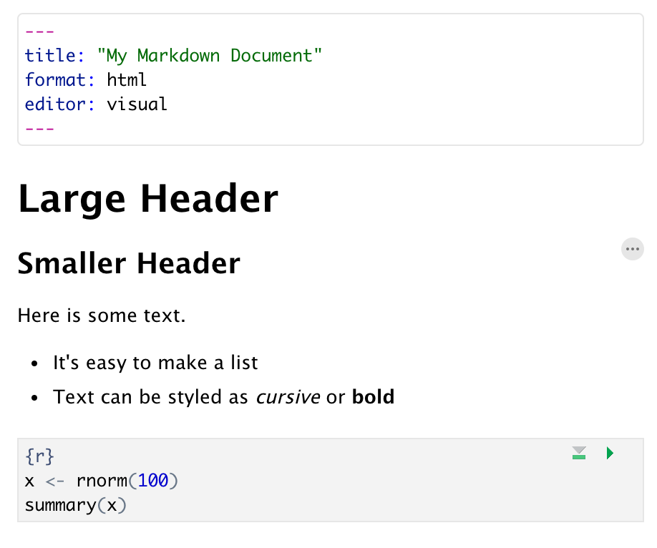
Anatomy of a Quarto Document
Header
Header
Text (w/ formatting)
Code chunk
Notes:
Quarto documents are composed of 3 basic building blocks.
**The first is the Header which includes pieces like the name of the document, the document’s author, and the desired output format when the document is assembled.
**The second block is the text. Quarto documents can be marked in ways that promote readability with various formatting styles.
**Finally, there are code chunks. Code chunks include include R code that can be executed to output results.

Slide 12
5 Minute Intro to R

Slide 13
The Data Analysis Pipeline
Notes:
This diagram may look familiar, you saw it in the Welcome presentation.
The first step in the data analysis pipeline is to load the data into the environment so we can begin to tidy and transform that data.
In today’s course we will be using a de-identified data set consisting of COVID-19 laboratory test results from a microbiology lab. This data is stored as a CSV file.

Slide 14
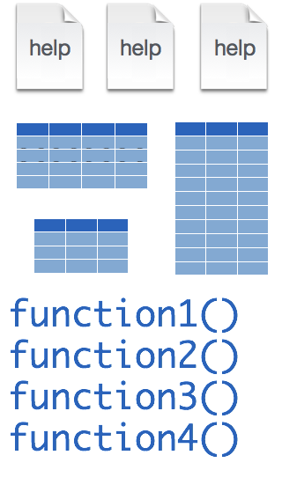
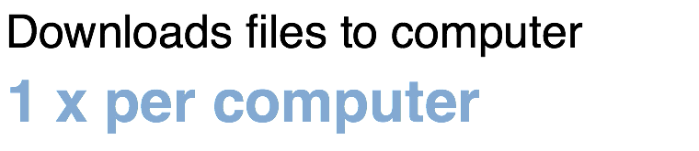
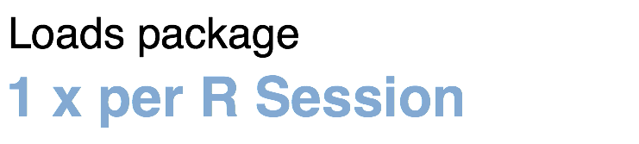
Installing and loading R packages
REDCapR
install.packages("REDCapR")
library("REDCapR")
Notes:
The Tidyverse is package (a collection of functions, data, and help documentation) that we can use to extend the functionality of R.
Packages need to be installed explicitly – with the command install.packages. So let’s say you want to install a package named “tidyverse”. You go to the R Console and type install.packages(“tidyverse”).
Each package you want to use needs to be installed only once on each computer. However, in order to use the functions or data in the package, you also need to load the package. This is done with the command “library”. So to enable all the functions in the “tidyverse” package, you type library(“tidyverse”). Packages remain loaded until you quit R. So every time you start a new R session you have to load each package that you want to use again.
On our RStudio Server, you won’t need to install any packages for this course (we have installed them for you). But at times in this course you’ll need to load packages. We’ll practice this later.
So these are the first two R commands we’ve covered - install.packages and library.

Slide 15
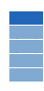


retrieve_credential_local()
creds <- retrieve_credential_local(file_name, pid)
csv
Notes:
There is a lot of R going on in the second line of code.
…
Once, the Tidyverse package has been loaded via library, we can import CSV files using the read_csv() function.
Here is a template for how to use the read_csv function to create a data frame object from a CSV file.
You start with the name of a data frame object then you have this left-ward arrow then read_csv and then the file name in parentheses.

Slide 16
object
(stores output)
function
(does stuff)
arguments
(inputs)
creds <- retrieve_credential_local(file_name, pid)
assignment operator
(“gets”)
Notes:
There is a lot of R going on in the second line of code.
…
Once, the Tidyverse package has been loaded via library, we can import CSV files using the read_csv() function.
Here is a template for how to use the read_csv function to create a data frame object from a CSV file.
You start with the name of a data frame object then you have this left-ward arrow then read_csv and then the file name in parentheses.

Slide 17
uri <- creds$redcap_uri
creds
redcap_uri | "https://redcap.chop.edu/api/"
username | "myusername"
project_id | 1
token | "37BCFC38D45F10C47EAF4D8B97BFC32F"
comment | CAR-T cell trials
uri
"https://redcap.chop.edu/api/"

Slide 18
dollar operator
extracts an element from a list
uri <- creds$redcap_uri
list
a type of object that can contain
multiple arbitrary objects

Slide 19

Recap
Quarto allows …
Essential concepts in R include packages which extend the functionality of R by providing new functions; functions, which do stuff; assignment of names to objects; and list objects which contain other objects that can be extracted with the $ operator.
Notes:
To recap what we covered up to this point, …

